Slide 1
Did you know?
The COVID-19 vaccine can alter your human DNA?

Slide 2
Did you know?
The COVID-19 vaccine has a microchip that tracks your location and movement?

Slide 3
Did you know?
That COVID-19 can spread through wireless and mobile networks using 5G?

Slide 4
Did you know?

Slide 5
It's All Fake News

Slide 6
Fake News Detection
ISM 6251

Slide 7
Table of Contents
1
2
3
Industry |  | Motivation |  | Data Summary
4
5
6
Model Overview |  | Evaluation |  | Business Value

Slide 8
Industry
The primary application of this tool is combating misinformation by focusing on fake news detection.
Fake news detection is critical in various industries, including:
Social Media
Journalism
Technology
Government
Healthcare
Etc.

Slide 9
Business Application
Social Platforms
Government
Flagging tool to maintain user trust
Public remains accurately informed during crises and political campaigns
Journalism
Healthcare
Screen press releases, news articles, and user-generated content
Monitor and counter health-related misinformation
Tech Companies
And Many More!
Real-time news verification and data-driven decision-making
The identification of fake news will benefit all industries

Slide 10
Motivation
The primary motivation behind developing this fake news detection tool is to:
Address the growing threat of misinformation, which can undermine public safety, democracy, and organizational credibility.
Equip industries with innovative solutions to safeguard trust and maintain accurate public communication.
Misinformation spreads rapidly and can damage reputations, mislead the public, and impact societal welfare. This machine learning-based tool provides:
A practical solution to detect and reduce fake news in real-time.
Support for industries like social media, journalism, government, and healthcare in protecting public trust and reducing the spread of misinformation.

Slide 11
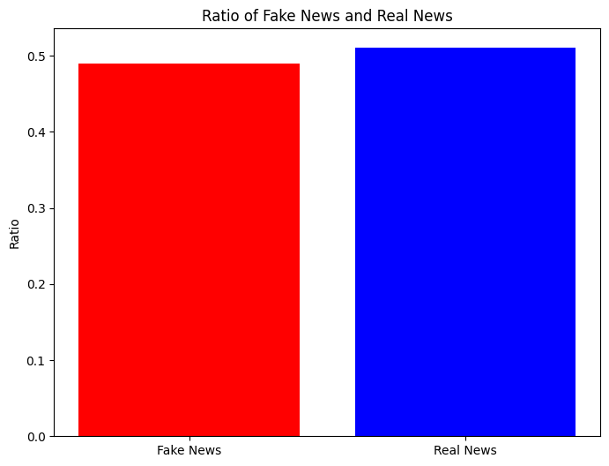
Data Summary
Data
72,137 News Articles
35,028 Real
37,106 Fake
Features
WELFake
Serial Number (starting from 0)
Title (about text news heading)
Text (about news content)
Dependent Variable
Label
0 = Fake
1 = Real

Slide 12
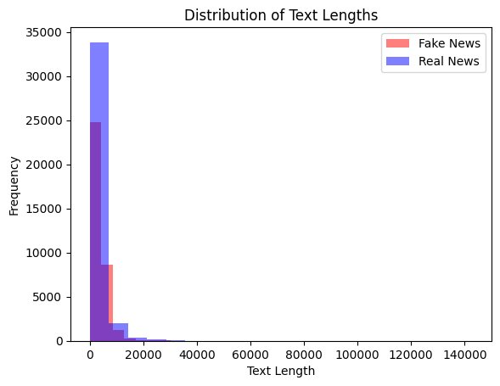
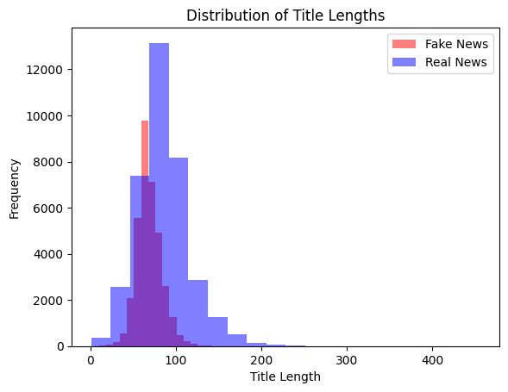
Text & Title Length
Title Length
Text Length
Real News has a longer title at a much higher frequency than Fake News
For both, frequencies drop significantly beyond 20,000 characters

Slide 13
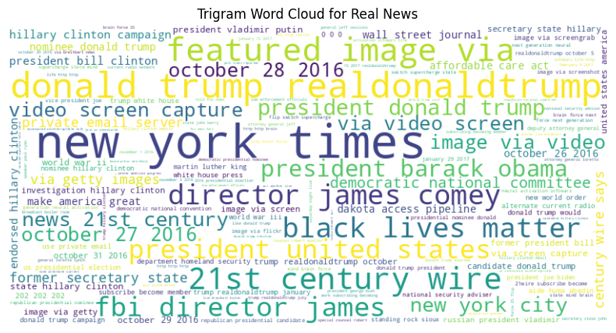
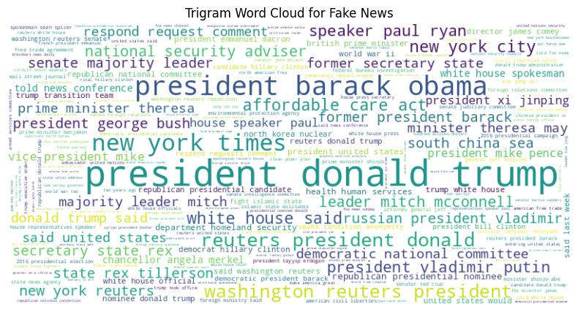
Word Cloud
Real
Fake
New York Times
1
1
President Donald Trump
Real
Fake
Donald Trump Real
2
2
President Barack Obama

Slide 14
Model Overview
Goal: To build a real-time tool that detects fake news using machine learning algorithms
1
Algorithms Explored:
Support Vector Machine (SVM)
Logistic Regression
Naive Bayes
2
Best Model: SVM
3
Text Classification
Precision
Recall

Slide 15
Evaluation
1
2
3
Evaluation Criteria
Evaluation Results
Confusion Matrix
Accuracy: The model's ability to correctly identify real vs. fake news articles.
Precision & Recall: Assessing the model's ability to avoid false positives and false negatives.
F1 Score: The balance between precision and recall.
SVM Performance: The SVM model achieved the highest accuracy among the three models tested, making it the best-performing choice.
Precision: SVM effectively minimized false positives, ensuring that real news wasn't flagged incorrectly.
Recall: The model demonstrated strong recall, identifying most instances of fake news with few missed cases.
F1 Score: The SVM model balanced precision and recall well, providing a robust solution for fake news detection.
Highlights the results of the confusion matrix, showing the performance of SVM in terms of true positives, false positives, true negatives, and false negatives.

Slide 16
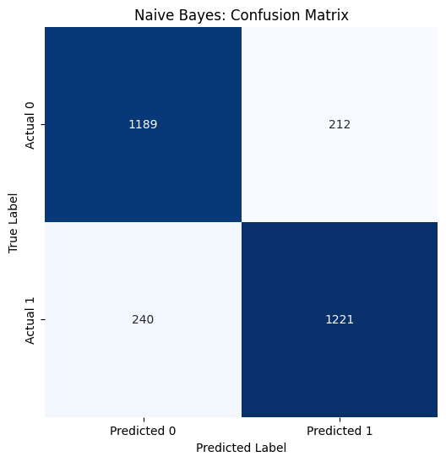
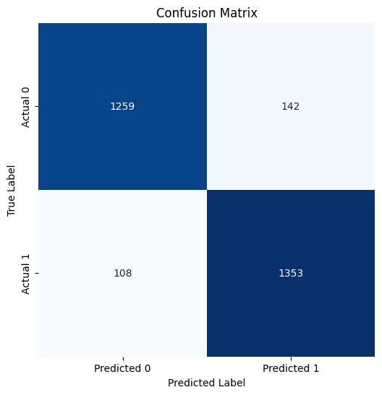
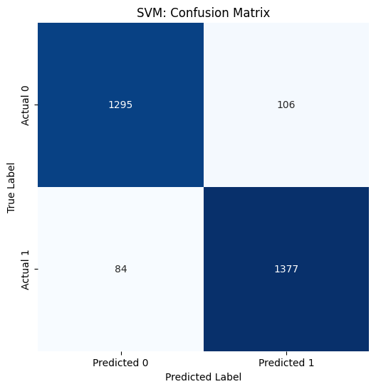
Confusion Matrix
Logistic Regression
SVM
Naive Bayes
Type 1 Error: 142 Type 2 Error: 108
Type 1 Error: 106 Type 2 Error: 84
Type 1 Error: 212 Type 2 Error: 240

Slide 17
Business Value
Industry Benefits:
Real-Time Detection:
Social Media: Prevents the spread of misinformation on platforms like Facebook and Twitter, preserving user trust.
Journalism: Helps media organizations maintain journalistic integrity by quickly verifying news sources.
Tech Companies: Provides AI-driven solutions for companies to integrate into their cloud-based services, enhancing data-driven decision-making.
Governments & Healthcare: Ensures the public receives accurate information during crises (e.g., elections, public health emergencies).
Enables immediate identification and flagging of fake news to ensure credible information dissemination.
Impact on Public Trust:
By identifying fake news before it spreads, organizations can maintain credibility and reduce the reputational damage caused by misinformation.
Supports regulatory compliance and responsible digital behavior in platforms and businesses.
Long-Term Value:
Scalability: The model can be easily adapted and scaled to accommodate new forms of digital content and more complex data types.
Innovation in AI & ML: Promotes responsible AI use, positioning companies as leaders in the fight against misinformation.

Slide 18
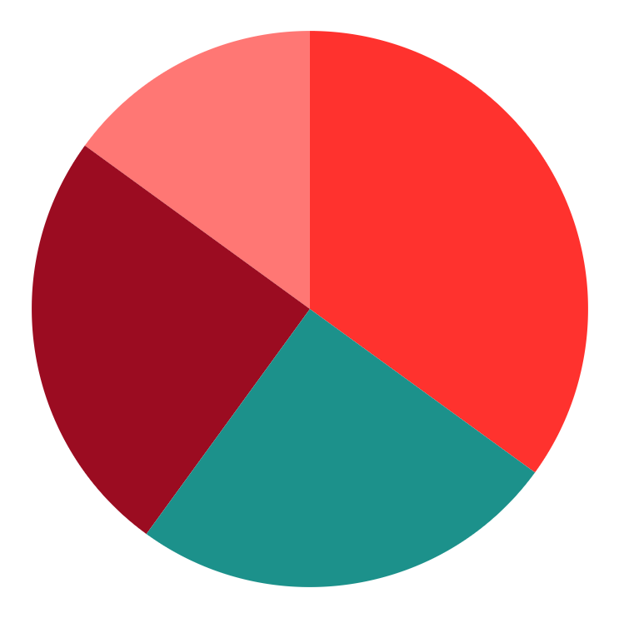
Group Member Task Breakdown
Ryan
Niharika
Report Presentation Slides
Report
Zahid
Sucharitha
Kai
Python Workbook
Report
Presentation Slides

Slide 19
References
Mayo Clinic Staff. "COVID-19 Myths Debunked." Mayo Clinic, Mayo Foundation for Medical Education and Research, 3 Mar. 2023, www.mayoclinic.org/diseases-conditions/coronavirus/in-depth/coronavirus-myths/art-20485720.
Martin, Emily. "Fake News, Social Media, and the Death of Truth." CBS News, CBS Interactive, 2 May 2023, www.cbsnews.com/news/fake-news-social-media-and-the-death-of-truth/.
"Commentary: Tech Companies' Inability to Control Fake News Exacerbates Violent Acts." Business & Human Rights Resource Centre, Business & Human Rights Resource Centre, 18 Oct. 2023, www.business-humanrights.org/en/latest-news/commentary-tech-companies-inability-to-control-fake-news-exacerbates-violent-acts/.
Columbia School of Professional Studies. "The Real Impact of Fake News: The Rise of Political Misinformation and How We Can Combat Its Influence." Columbia University, School of Professional Studies, 10 Sept. 2023, sps.columbia.edu/news/real-impact-fake-news-rise-political-misinformation-and-how-we-can-combat-its-influence.
Office of the U.S. Surgeon General. "Confronting Health Misinformation." U.S. Department of Health and Human Services, 15 Aug. 2023, www.hhs.gov/surgeongeneral/priorities/health-misinformation/index.html.

Slide 20
Thank You

